Slide 1
Syntactic Parsing
Human Language from a Computational Perspective
April 25, 2018

Slide 2
Language models reminder
wish I | 8
wish is | 6
wish they | 4
wish was | 4
wish that | 2
wish you | 1
Use an n-gram model to predict the next token:
My only wish
wish I | 8
wish is | 6
wish they | 4
wish was | 4
wish that | 2
wish you | 1
* My only wish I
My only wish I
My only wish is
Bigram counts
(starting with wish):

Slide 3
Lexical ambiguity
The word wish is ambiguous
wish (verb): לבקש, לאחל
wish (noun): משאלה

Slide 4
Some context helps
Verb:
How I wish you were here
Careful what you wish for
Wish you a happy birthday
Noun:
Your wish is my command
If you could have one wish
Make a wish

Slide 5
But sometimes it doesn’t
Squad helps dog bite victim
Eye drops off shelf
Reagan wins on budget, but more lies ahead

Slide 6
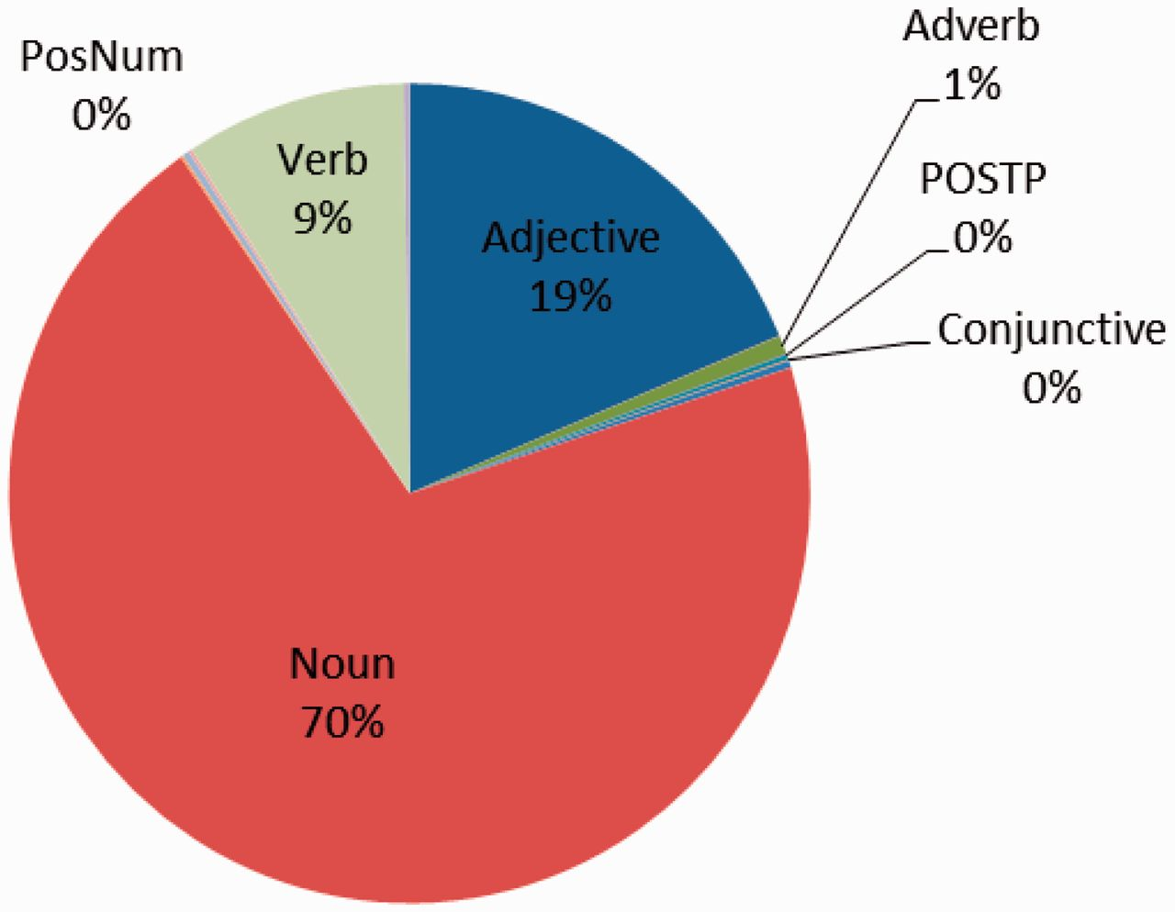
Parts of speech (POS)
Words can roughly be divided into distributional categories based on their syntactic roles.

Slide 7
Part-of-speech hierarchy
Open classes
Closed classes
Nouns
Verbs
Determiners some, the
Proper
Hebrew
John
Common
arrival
pencils
Main
went
write
Modals
would
shall
Conjunctions and, or
Pronouns you, my, us
Adjectives
tall
Adverbs
quickly
Numbers
2015, 1/2, billion, one
Prepositions to, in, by
...
...

Slide 8
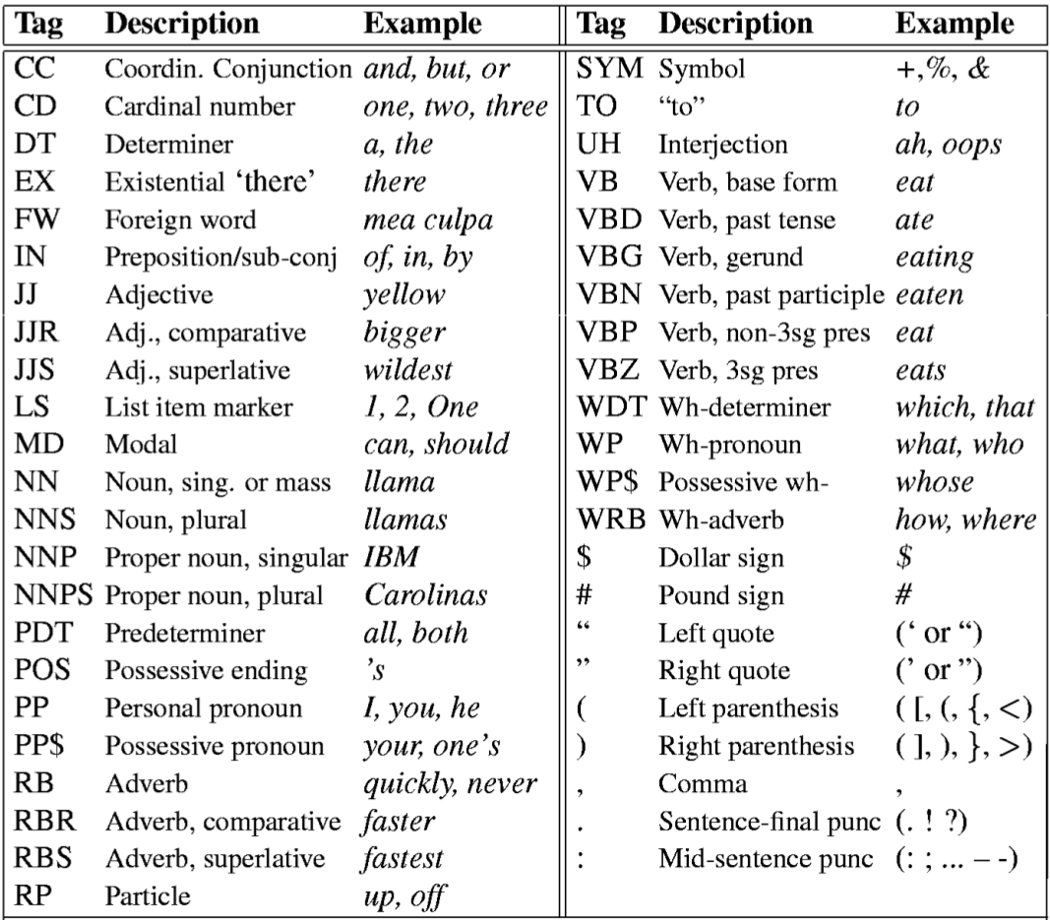
Part-of-speech tags
Tag guide:
https://catalog.ldc.upenn.edu/docs/LDC99T42/tagguid1.pdf
Penn Treebank Part-of-Speech Tags for English

Slide 9
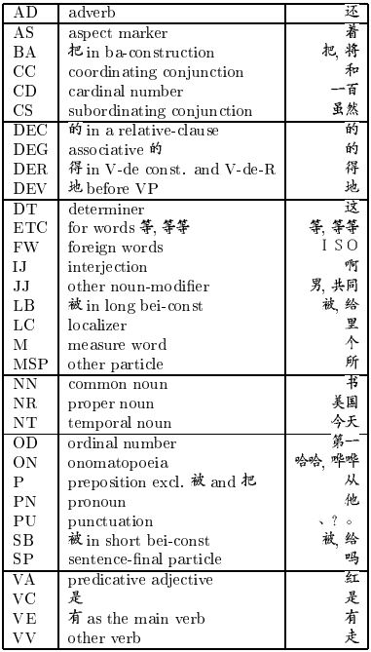
Language variations
Penn Treebank Part-of-Speech Tags for Mandarin Chinese

Slide 10
Part-of-speech tagging
Tag the following text for POS:
Alice | was | beginning | to | get | very | tired
nnp | vbd | vbg | to | vb | rb | jj
Notes:
Understand the task?
Suggest ideas!

Slide 11
Statistical POS tagging
We can use counts from the corpus to tag text for POS,
but it requires annotation:
just the text is not enough.

Slide 12
Annotated corpus example
Alice/NNP was/VBD beginning/VBG to/TO get/VB very/RB tired/JJ of/IN sitting/VBG by/IN her/PRP$ sister/NN on/IN the/DT bank/NN ,/, and/CC of/IN having/VBG nothing/NN to/TO do/VB ./. Once/RB or/CC twice/RB she/PRP had/VBD peeped/VBN into/IN the/DT book/NN her/PRP$ sister/NN was/VBD reading/VBG ,/, but/CC it/PRP had/VBD no/DT pictures/NNS or/CC conversations/NNS in/IN it/PRP ,/, ''/'' and/CC what/WDT is/VBZ the/DT use/NN of/IN a/DT book/NN ,/, ''/'' thought/VBD Alice/NNP ,/, ''/'' without/IN pictures/NNS or/CC conversations/NNS ?/. ''/'' So/CC she/PRP was/VBD considering/VBG in/IN her/PRP$ own/JJ mind/NN

Slide 13
Word/tag counts
Simple method: count the times each word occurred with each POS in the corpus
the | dt | 1527
well | rb | 37
well | nn | 3
sleep | nn | 4
sleep | vbp | 2
that | in | 197
that | dt | 50

Slide 14
Algorithm to count word/tag
count(L, T): ▹ L: list of tokens, T: list of correct tags
Cwt ← [0] ▹ create a table of zeros
i ← 1 ▹ assign 1 to i
while i ≤ len(L): ▹ repeat while i is at most len(L)=len(T)
Cwt[L[i], T[i]] ← Cwt[L[i], T[i]] + 1 ▹ increment count
i ← i + 1 ▹ increment i
return Cwt ▹ output is the counts table

Slide 15
POS tagging algorithm
Find POS sequence of token sequence
[bob went out for a swim .] → [nnp vbd in in dt nn .]
This is the wanted result, but no algorithm is perfect

Slide 16
POS tagging algorithm 1
tag1(L, Cwt): ▹ L: tokens, Cwt: word-tag counts
T ← [] ▹ create empty list of tags
i ← 1 ▹ initialize i to 1
while i ≤ len(L): ▹ repeat for all tokens
T[i] ← argmax(Cwt[L[i], ·]) ▹ most common tag for L[i]
i ← i + 1 ▹ increment i
return T ▹ output is list of tags

Slide 17
POS tagging algorithm 1
tag1(L, Cwt): ▹ L: tokens, Cwt: word-tag counts
T ← [] ▹ create empty list of tags
i ← 1 ▹ initialize i to 1
while i ≤ len(L): ▹ repeat for all tokens
T[i] ← argmax(Cwt[L[i], ·]) ▹ most common tag for L[i]
i ← i + 1 ▹ increment i
return T ▹ output is list of tags
The same algorithm as prediction with bigram model

Slide 18
Surprising accuracy
This simple approach actually gets about 90% of the POS tags correctly!
Most words almost always appear with the same POS.

Slide 19
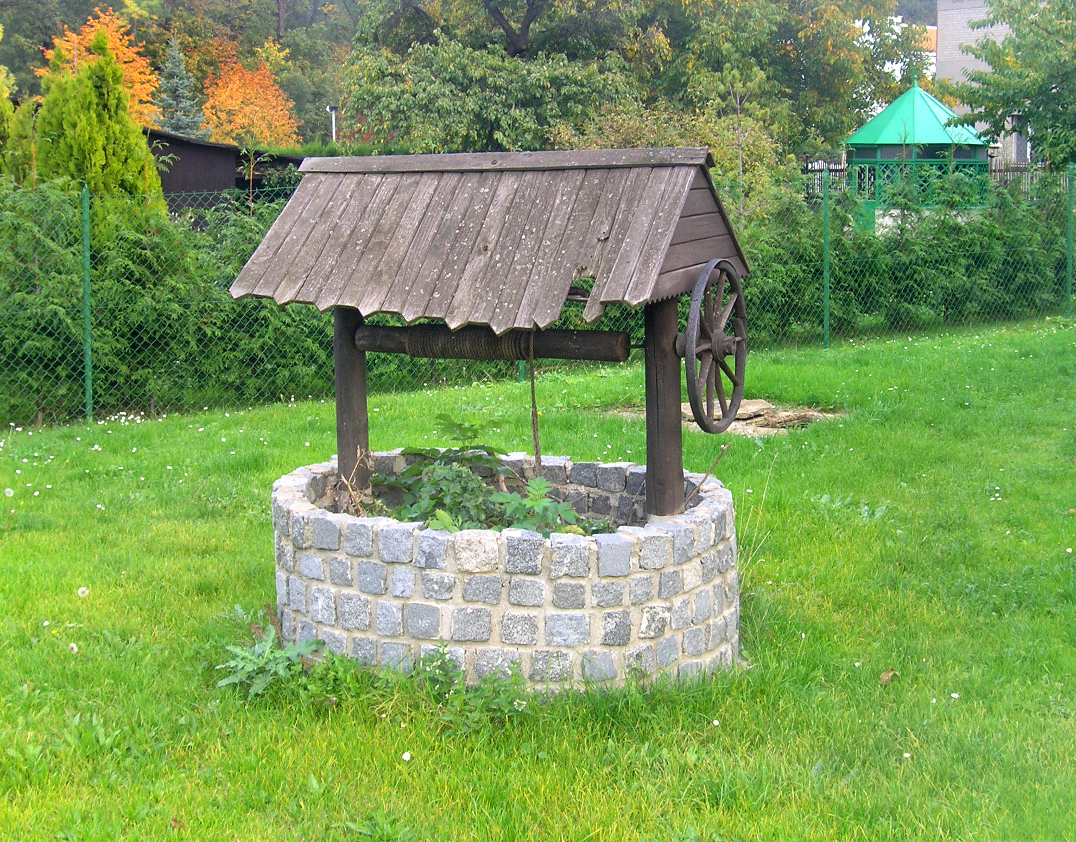
Problem 1: variability
Use the most common POS for each word
the | fish | sleep | in | that | well
dt | nn | nn | in | in | rb
dt | nn | nn | in | in | rb
But the correct tags are:
dt | nns | vbp | in | dt | nn
Notes:
fish/NN: a small fish is swimming in the river
sleep/NN: I had a long sleep this afternoon
that/IN: people think that he is rich
well/RB: she did well in the test

Slide 20
State of the art
The best methods today get slightly more than 97% accuracy,
so 90% is not so bad.

Slide 21
Problem 2: unknown words
't was brillig , and the slithy toves did gyre and gimble in the wabe ; all mimsy were the borogoves , and the mome raths outgrabe .
? | vbd | ? | , | cc | dt | ? | ?
First stanza of Jabberwocky from Through the Looking-Glass, and What Alice Found There (1871) by Lewis Carroll
vbd | ? | cc | ? | in | dt | ? | :
dt | ? | vbd | dt | ? | ,
cc | dt | ? | ? | ? | .

Slide 22
Solutions
Context (above the word level)
Morphology (below the word level)

Slide 23
Transition counts
Count the times each tag follows another tag.
These are tag bigram counts (transition counts).
nn | nn | 312
nn | in | 690
nn | dt | 113
in | nn | 262
dt | nn | 1256
prp | vbd | 847
vbd | dt | 464
Notes:
Actually has the same structure as before: [string, string] -> number

Slide 24
Algorithm to count tag pairs
count(T): ▹ T: list of correct tags from corpus
Ct2 ← [0] ▹ create a table of zeros
i ← 2 ▹ assign 2 to i
while i ≤ len(L): ▹ repeat while i is at most len(L)
Ct2[T[i − 1], T[i]] ← Ct2[T[i − 1], T[i]] + 1 ▹ increment
i ← i + 1 ▹ increment i
return Ct2 ▹ output is the counts table
The same algorithm as for counting word bigrams

Slide 25
POS tagging algorithm 2
tag2(L, Cwt, Ct2): ▹ L: tokens, Cwt: word-tag counts,
T ← [] ▹ Ct2: tag bigram counts
T[1] ← argmax(Cwt[L[1], ·]) ▹ most common tag for first token
i ← 2 ▹ initialize i to 2
while i ≤ len(L): ▹ repeat for all tokens
T[i] ← argmax(Cwt[L[i], ·] × Ct2[T[i − 1], ·])▹ multiply counts
i ← i + 1 ▹ increment i
return T ▹ output is list of tags

Slide 26
POS tagging algorithm 2
tag2(L, Cwt, Ct2): ▹ L: tokens, Cwt: word-tag counts,
T ← [] ▹ Ct2: tag bigram counts
T[1] ← argmax(Cwt[L[1], ·]) ▹ most common tag for first token
i ← 2 ▹ initialize i to 2
while i ≤ len(L): ▹ repeat for all tokens
T[i] ← argmax(Cwt[L[i], ·] × Ct2[T[i − 1], ·])▹ multiply counts
i ← i + 1 ▹ increment i
return T ▹ output is list of tags
Multiply corresponding elements in the two tables

Slide 27
Combining counts
Cwt
the | dt | 1527
well | rb | 37
well | nn | 3
sleep | nn | 4
sleep | vbp | 2
Ct2
nn | nn | 312
nn | in | 690
nn | rb | 113
in | nn | 262
dt | nn | 1256
Tag the short sentence: sleep well

Slide 28
Combining counts
Cwt
the | dt | 1527
well | rb | 37
well | nn | 3
sleep | nn | 4
sleep | vbp | 2
Ct2
nn | nn | 312
nn | in | 690
nn | rb | 113
in | nn | 262
dt | nn | 1256
Tag the short sentence: sleep well
nn

Slide 29
Combining counts
Cwt
the | dt | 1527
well | rb | 37
well | nn | 3
sleep | nn | 4
sleep | vbp | 2
Ct2
nn | nn | 312
nn | in | 690
nn | rb | 113
in | nn | 262
dt | nn | 1256
nn: 3×312=936
rb: 37×113=4181
Tag the short sentence: sleep well
nn rb

Slide 30
Phrases
Parts of speech are for single words, but multi-word phrases may have similar syntactic roles.

Slide 31
Noun phrases (NP)
I saw a [dog]
[small dog]
[small dog with a black tail]

Slide 32
Verb phrases (VP)
I [walk]
I [walk home]
I [walk home quickly but surely]

Slide 33
Adjective phrases (AP)
This car is [fast]
This car is [really very fast]
This car is [faster than my old one]

Slide 34
Prepositional phrases (PP)
Cats fall [on their feet]
I’m wearing the shirt [from Italy]
I’m taking the bus [from Tel Aviv]

Slide 35
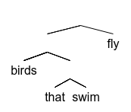
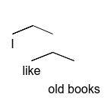
Bracketing
A hierarchy of constituents
[[birds [that swim]] fly]
[i [like [old books]]]

Slide 36
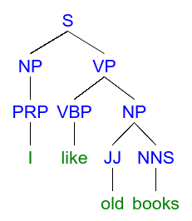
Phrase structure
Represents text structure as a tree: tokens are leaves
mshang.ca/syntree

Slide 37
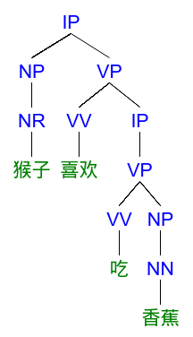
Chinese example
Different rules/labels are used for different languages

Slide 38
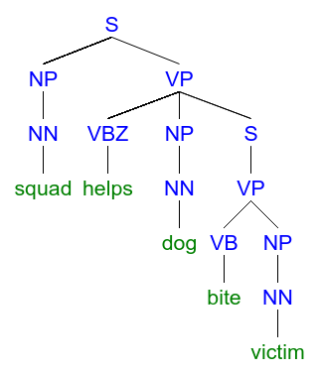
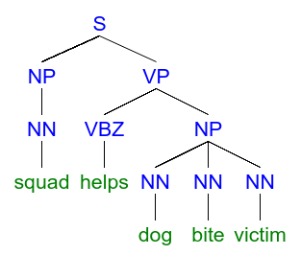
Lexical ambiguity

Slide 39
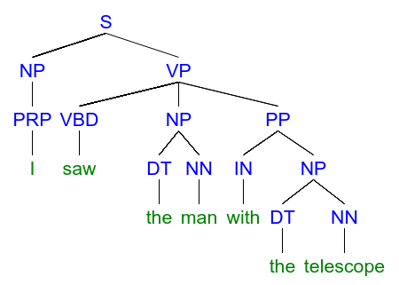
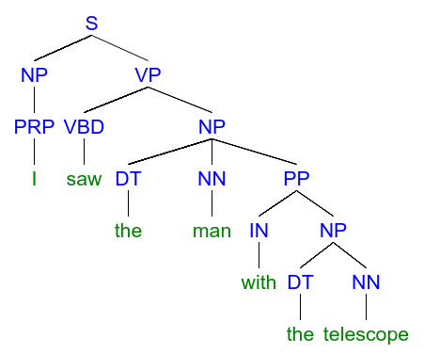

Syntactic ambiguity

Slide 40
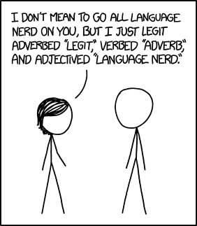
xkcd.com/1443

Slide 41
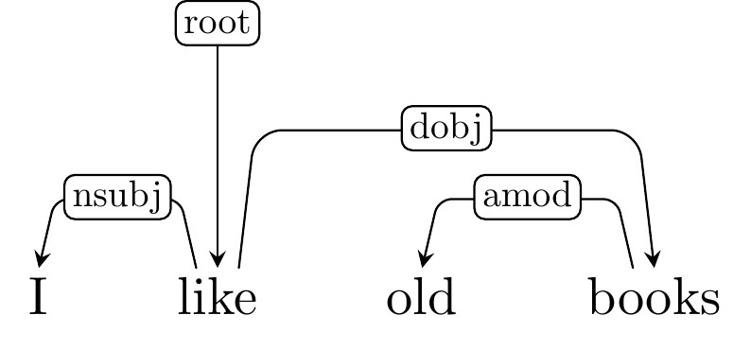
Dependency parsing
Represents text structure as a tree: tokens are all the nodes (not just leaves)

Slide 42
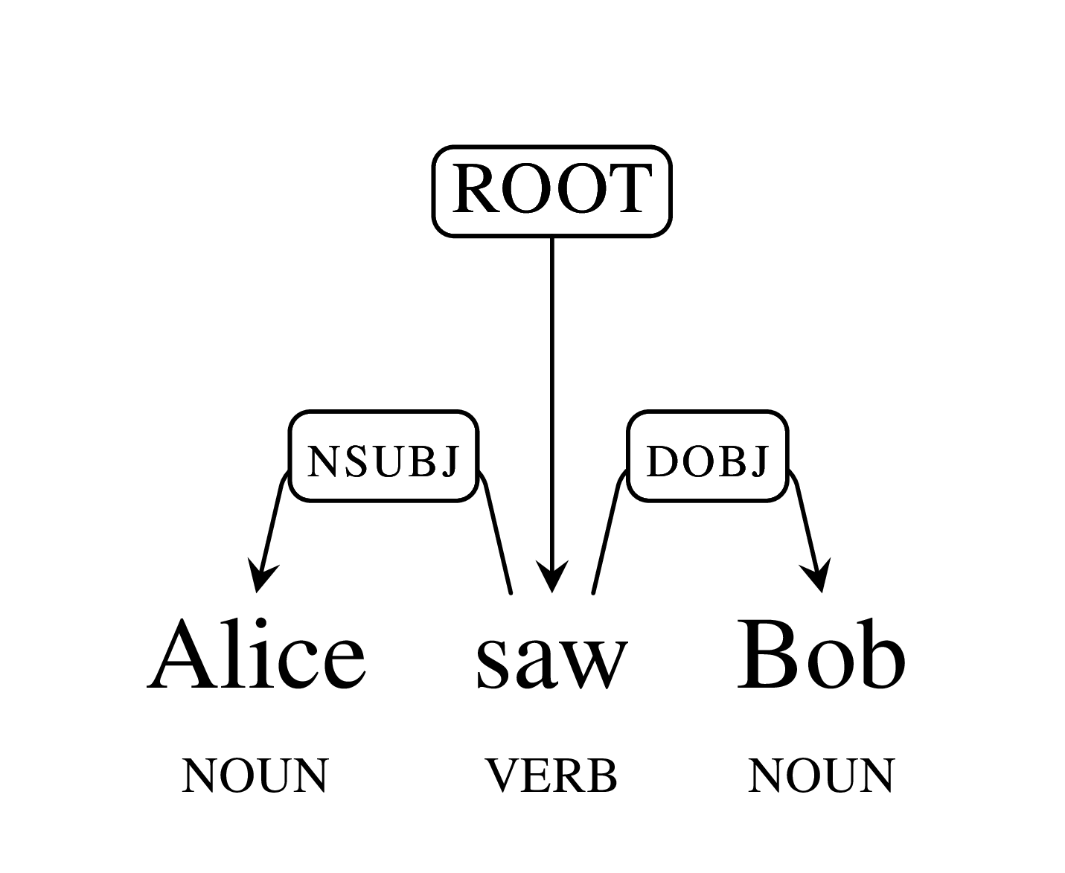
Dependency Parsing
googleresearch.blogspot.co.il/2016/05/announcing-syntaxnet-worlds-most.html

Slide 43
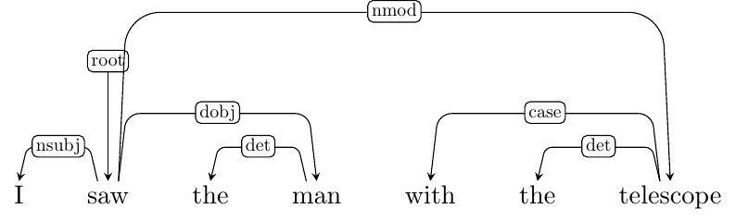
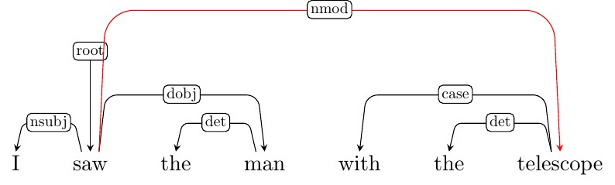
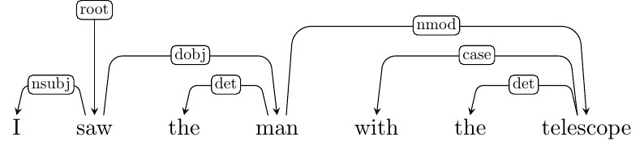
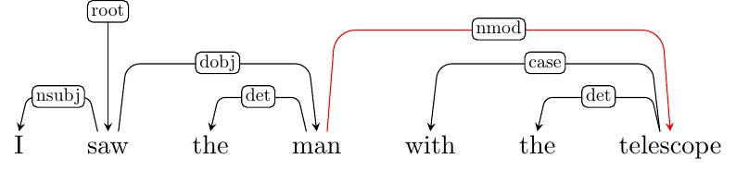
Syntactic ambiguity

Slide 44
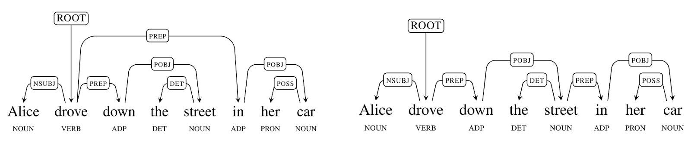
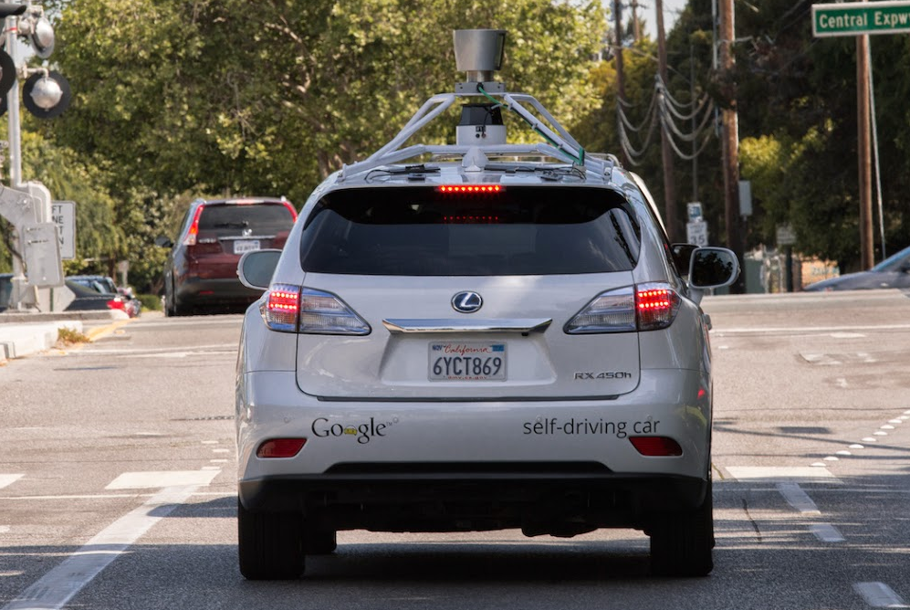
Syntactic Ambiguity

Slide 45
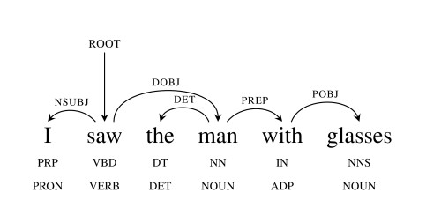
Syntactic Ambiguity
github.com/tensorflow/models/tree/master/syntaxnet
Who had the glasses?

Slide 46
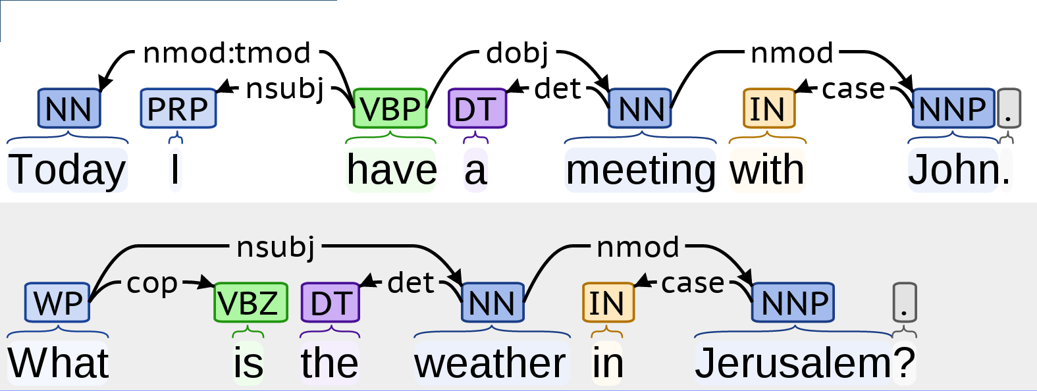
Representation
Natural Language Understanding: who did what to whom
and where and when and how and why?

Slide 47
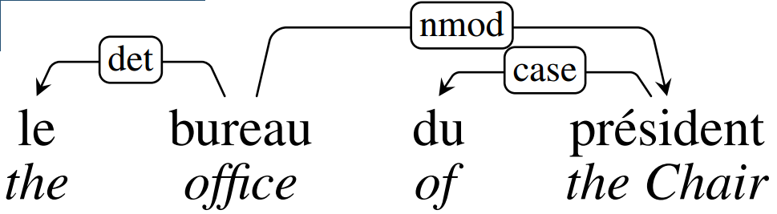
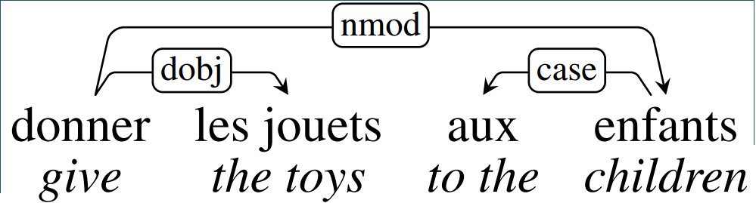
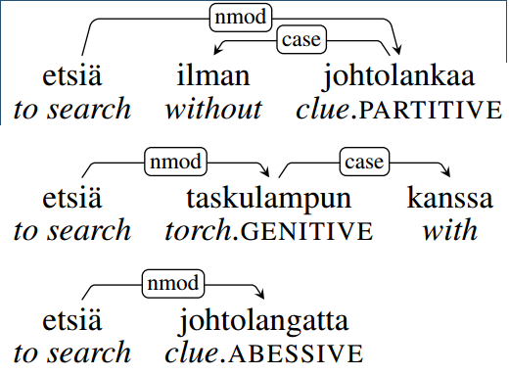
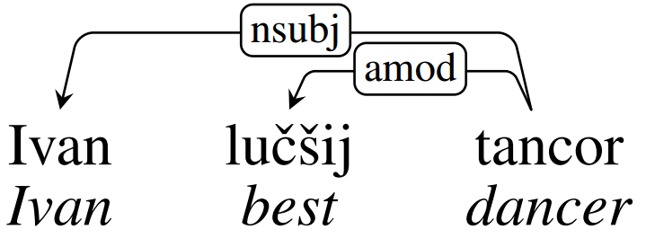
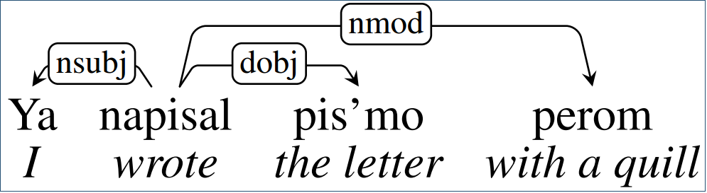
Cross-Linguistic Examples
universaldependencies.org
French
Russian
Finnish

Slide 48
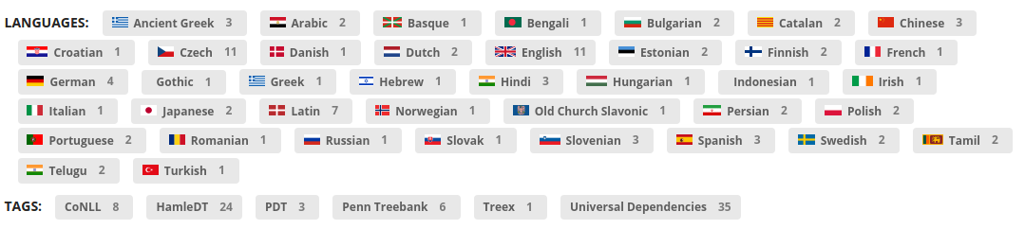
Resources: Treebanks
lindat.mff.cuni.cz/services/pmltq/#!/treebanks
Many text corpora parsed by humans
Used for training automatic parsers

Slide 49
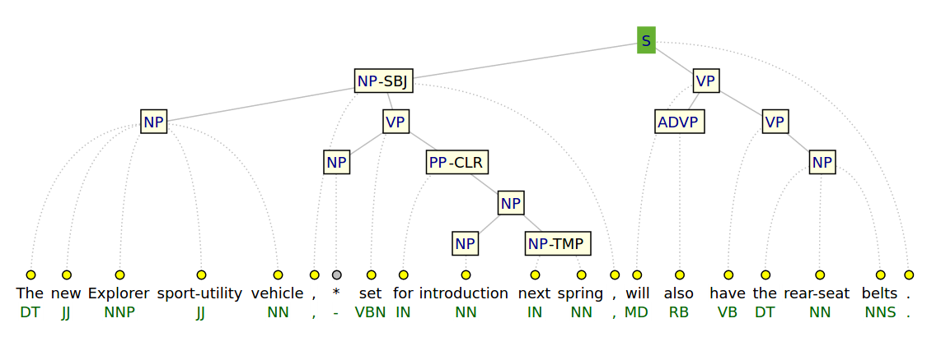
Penn Treebank (Constituency)
www.cis.upenn.edu/~treebank

Slide 50
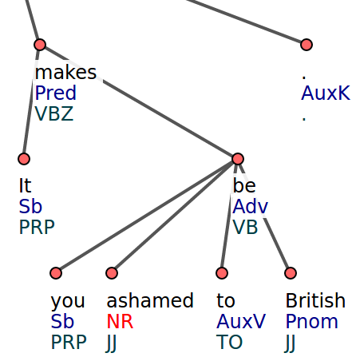
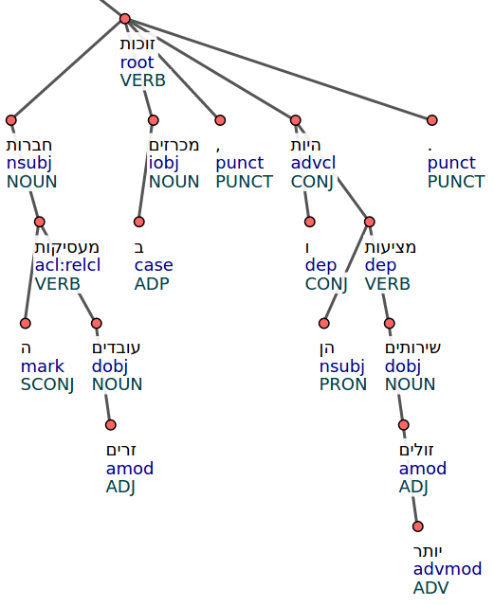
Dependency Treebanks

Slide 51
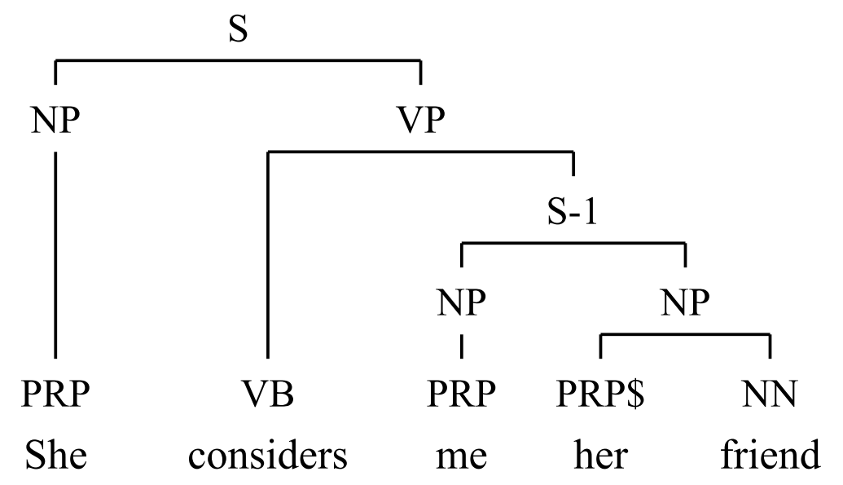
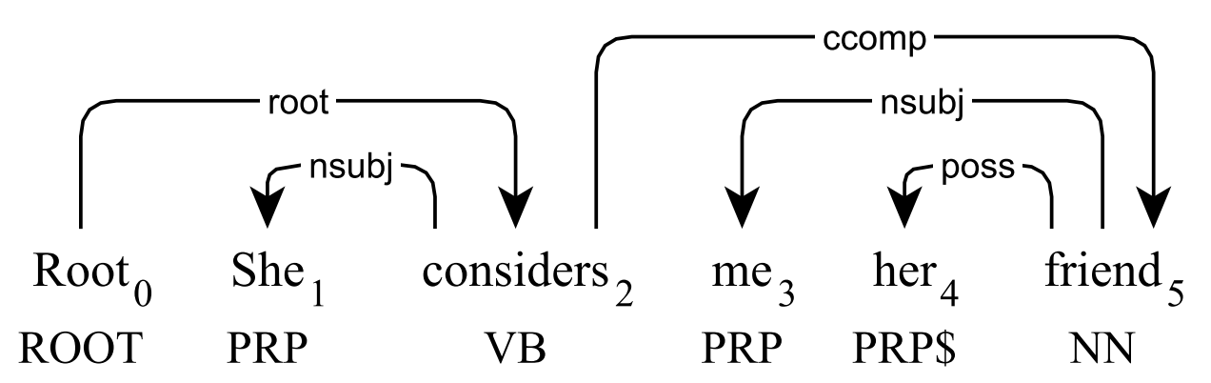
Converted Treebanks
Trees can be automatically converted to save manual work

Slide 52
Evaluation
Labeled Attachment Score (LAS):
% of edges both in predicted tree and in gold tree
Unlabeled Attachment Score (UAS):
same as LAS, but ignoring edge label
0 ≤ LAS ≤ UAS ≤ 100%

Slide 53
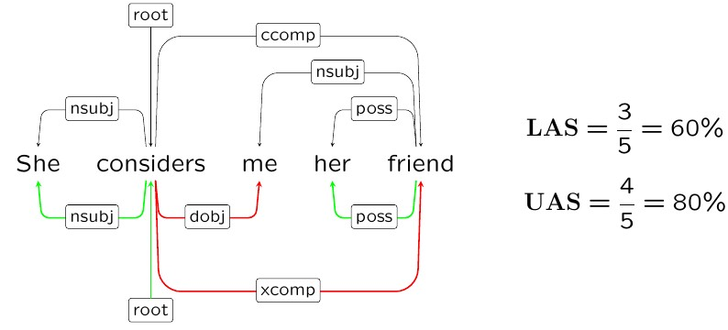
Evaluation Example
gold
predicted

Slide 54
Parser Scores
Parser | UAS | LAS
MaltParser | 90.93 | 88.95
MSTParser | 92.17 | 89.86
ZPar | 92.93 | 91.28
TurboParser | 93.80 | 92.00
Parsey McParseface | 94.41 | 92.55

Slide 55
Summary
 | Dependency | Constituency
Structure | tree | tree
Tokens are | all nodes | only leaves
Labels on | edges | nodes

Slide 56
References
NLP class on Coursera: class.coursera.org/nlp
Parts of speech: en.wikipedia.org/wiki/Part_of_speech
Jurafsky, Daniel, and James H. Martin. 2009. Speech and Language Processing: An Introduction to Natural Language Processing, Speech Recognition, and Computational Linguistics. 2nd edition. Prentice-Hall. Pg. 295.

